Slide 1

A Project Presentation
On
Animatronic Hand using Mechatronics Technology
Presented by
Represented to
Siddhant Pratap Singh (1743120043)
Project Guide
Akanksha Tiwari (1743120003)
Dr. Abhishek Mishra
Additional Director, HOD of EE & EC
Jai Hind (1743120017)
Utkarsh Pandey (1743120049)
Project In-charge
KM Adab Istiaq (1743120019)
Mr. Sushil Kumar
Rajan Joshi (1743120033)
Department of Electrical Engineering

Slide 2
PLAN OF PRESENTATION
Objective
Introduction
Components Used
Working of project
System Algorithm
Hardware Implementation
Software Implementation
Final Steps : Wiring of the Total Circuit
Technology Used
Advantages
Disadvantages
Application
Future Scope
Question ???

Slide 3
OBJECTIVE
The objective of this project is to design a robotic hand controlled by a human, in order to obviate human intervention in certain deleterious applications.
The Animatronic Hand is a mechanical hand that is controlled with the help of an Arduino board.
The goal of the project is to design a useful and fully functional real-world system that efficiently translates the hand gesture into the movement of the fibber glass made hand.
This could be also further enhanced in various applications such as robotics, automation system etc. This project is based on the technology to help the deaf community.
We have design the hand which moves, forward, backword, left, right and stop based on the gesture of the user. The movement of the robotic hand is done by servo motor.

Slide 4
INTRODUCTION
Human gestures are undoubtedly natural. They may often prove more efficient and powerful as compared to various other modes of interaction.
The gesture are communicative, meaningful body motion- i.e. physical movement of the fingers, hands, arms, head, face, or body with the objective to convey information or interact with the environment.
In our work gesture recognition has been proposed to understand the action of a hand.
The user wears a glove with flex sensor the gesture made by user is sensed by flex sensor and is given at the microcontroller. This occurs at the transmitter end.
The microcontroller processes these signals & encodes it. These signals are transmitted to the receiver end.
At the receiver end, the received signal is decoded in the required form and makes the motor run.
Flex Sensor
Microcontroller
Servo Motor

Slide 5
COMPONENTS USED
Sr. No. | Components | Specification | Quantity
1. | ARDUINO | MEGA 2560 | 1
2. | SERVO MOTOR | SG90 (2.5K) | 3
3. | SERVO MOTOR | MIG996R (10K) | 2
4. | SERVO MOTOR | SMS4315 (14K TORQUE) | 1
5. | BREAD BOARD | SOLDER LESS | 1
6. | JUMPER WIRE | MALE, FEMALE, MALE - FEMALE | 3
7. | FLEX SENSOR | 4.5” | 5
8. | BATTERY | 11.1V | 1
9. | BATTERY CHARGER | N/A | 1
10. | CHARGER CONNECTING CABLE | N/A | 1
11. | POWER IC | N/A | 2
12. | PCB | N/A | 2

Slide 6
Sr. No. | Components | Specification | Quantity
13 | RESISTORS | 10K, 100K | 5
14 | POT | N/A | 2
15 | STRING | N/A | 5
16 | NEEDLE & THREAD | N/A | 1
17 | SUPER GLUE | N/A | 1
18 | A POWER DRILL | N/A | 1
19 | SPRING | N/A | 10
20 | RIGHT HAND GLOVE | N/A | 1
21 | WOOD | N/A | 2
22 | PLASTIC HUIS PIPES | N/A | 4

Slide 7
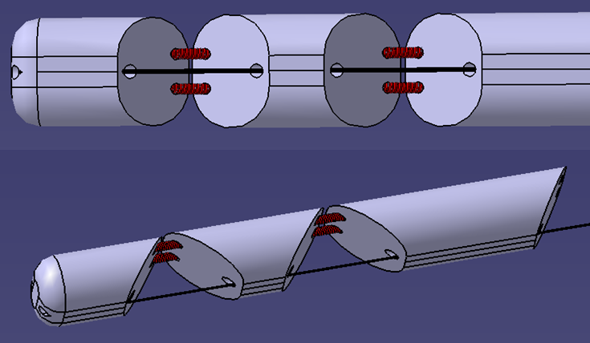
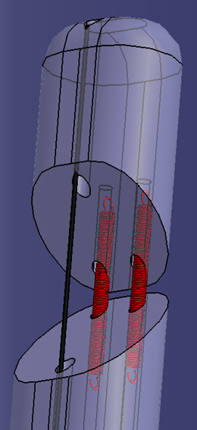
WORKING OF PROJECT
Our animatronic hand has five degree of freedom, one per each finger, each finger composed of three piece, in order to reproduce the human anatomy as much as possible: in fact every finger has a proximal.
The fingers components are linked to each other and to the rest of the hand by the use of two spring, so that lateral movement are avoided.

Slide 8
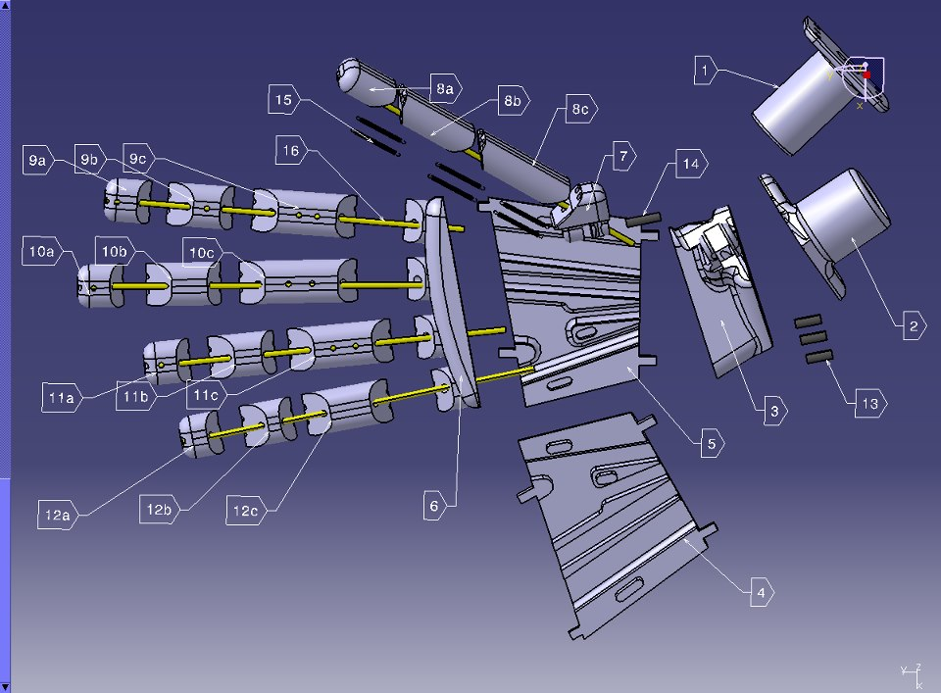
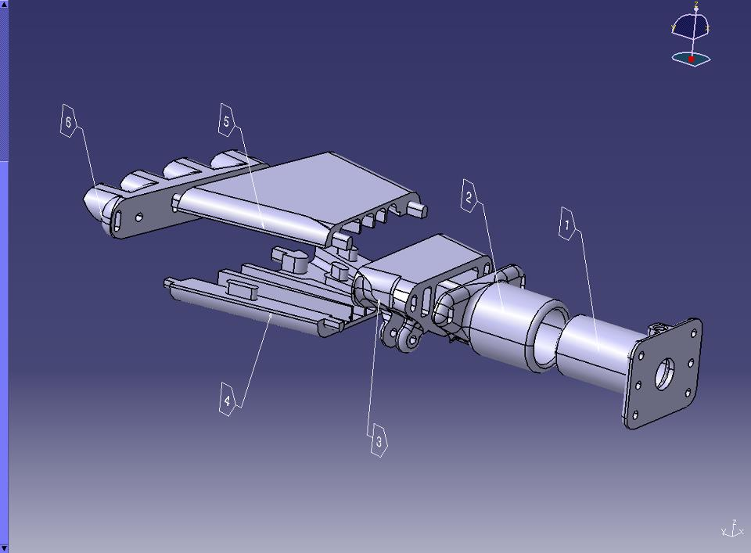

Slide 9
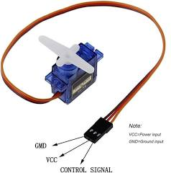
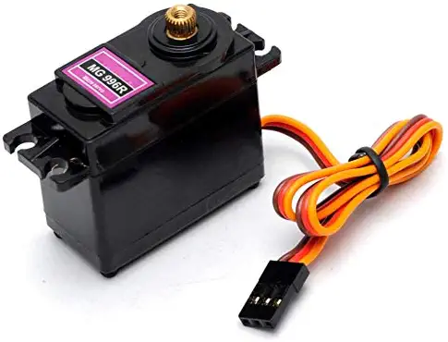
The working principle of this animatronic hand consists in having a fishing rod’s wire going through each finger and the main part of the hand, which is then connected to the horn of a servo motor; so we have an actuation system made of five servo motors attached on a wooden plate.
Servo motor
Servo SG90
Servo MG996R

Slide 10
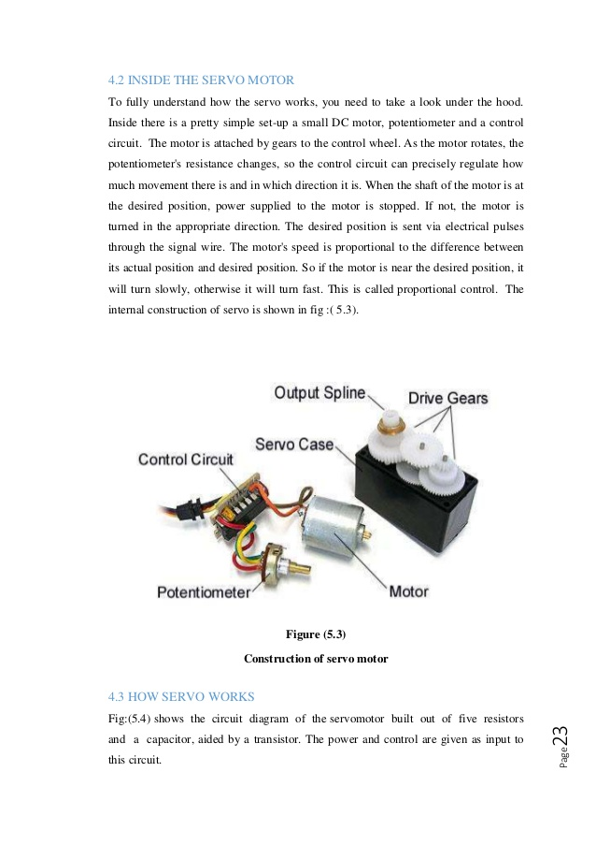
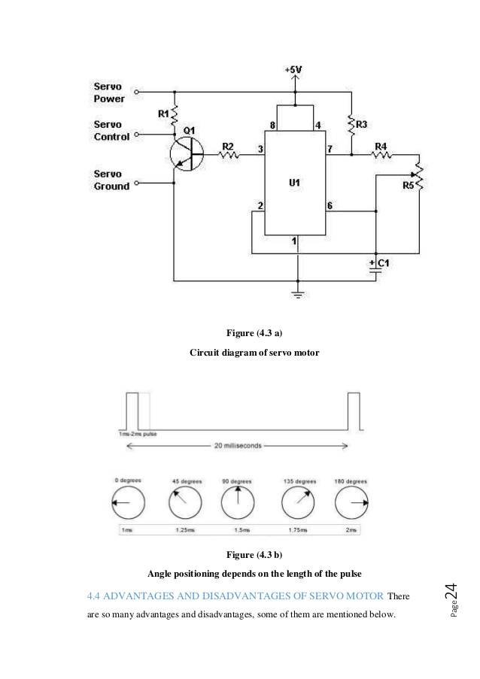
Inside the Servo Motor

Slide 11
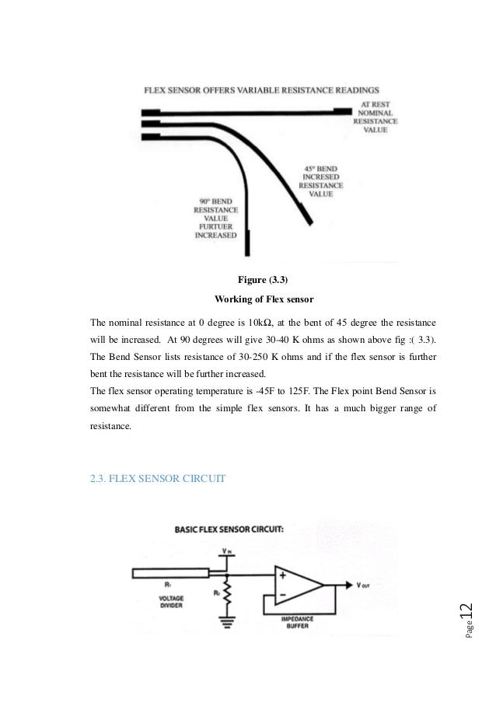
Flex Sensor
Flex sensor are analogue resistor, they are works as variable analogue voltage divider. Inside the flex sensors are carbon resistive elements within a thin flexible substrate.
More carbon means less resistance, when the substrate is bent the sensor produces a resistance output relative to the bent radius.
The higher resistance value yielding smaller radius.
The nominal resistance at 0 degree is 10kΩ at bent 45 degree the resistance will be increased. At 90 degree will give 30 – 40k Ω as shown in figure below.

Slide 12
Arduino
Arduino is an open source electronics prototype platform based on flexible, easy to use hardware and software.
The Arduino can sense the environment by receiving input from variety of sensor and can affect its surrounding by controlling lights, motors and other actuator.

Slide 13
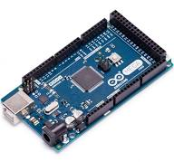
SYSTEM ALGORITHM
The Arduino runs a simplified version of the C programming language, with some extensions for accessing the hardware. All Arduino instructions are one line.
The board can hold a program hundreds of lines long and has space for about 1,000 two-byte variables.
The Arduino executes programs at about 300,000 source code lines per sec. Programs are created in the Arduino development environment and then downloaded to the Arduino board.
Code must be entered in the proper syntax which means using valid command names and a valid grammar for each code line.

Slide 14
The compiler will catch and flag syntax errors. before download. Sometimes the error message can be cryptic and you have to do a bit of hunting because the actual error occurred before what was flagged.
Style refers to our own particular style for creating code and includes layout, conventions for using case, headers, and use of comments.
All code must follow correct syntax, but there are many different styles we can use.
Here are some suggestions:
Starting every program with a comment header that has the program name and perhaps a brief description of what the program does.
Using indentation to line things up. Function name and braces are in column one. Mark major sections or functions with a comment header line or two.
Having just the right number of comments, not too few and not too many. Assume the reader knows the programming language so have the comment be instructive.
Here is an example of an instructive comment
digitalWrite(4,HIGH) // turn on motor and here is a useless comment
digitalWrite(4,HIGH) // set pin 4 HIGH

Slide 15
HARDWARE IMPLEMENTATION
We now try to explain the main steps of our assembly process:
Fingers
The three components of each finger, as well as the connection between the proximal part and the metacarpal upper edge of the hand, are linking by clicking the spring in the printed holes on the edges of both parts;
Handbreadth
All the parts which compose the base of the hand can be assembled by snap fitting mechanism provided by specific element present on each component; the fact that the handbreadth itself is made in two parts, makes the process of inserting the wires much easier.
Hand base
The two part at the bottom of the hand, the fixed edge and the rotational joint, are just guided into each other, and such that the possibility of having a part slipping out of the other one will not take place.
Wooden base
The base of the device consists of a wooden base on which the servomotor box and the robotic hand itself are fixed.

Slide 16
SOFTWARE IMPLEMENTATION
Software Download
Following the instructions on the Getting Started section of the Arduino web site, http://arduino.cc/en/Guide/HomePage . we at first downloaded the latest version of Arduino, arduino-1.0.5- windows.
Software Installation
Going all the way through the steps to where we saw the pin 13 LED blinking. This is the indication
that we had all software and drivers successfully installed and could start exploring with our own programs.
Software Execution
Connected our Arduino to the computer with the USB cable. We did not need the battery for that time. The green PWR LED will light. If there was already a program burned into the Arduino, it will run.
Started the Arduino development environment. In Arduino-speak, programs are called “sketches”, but here we will just call them programs. Our window would look something like this.
Then we clicked the Upload button or Ctrl-U to compile the program and load on the Arduino Bboard.

Slide 18
Final Steps : Wiring of the Total Circuit
After completing all the steps mentioned above we assembled all the stationary circuits together to
build the main circuit for execution. The main circuit diagram is given below:-

Slide 19
TECHNOLOGY USED
Animatronics is a multidisciplinary technology used to create robotic systems than seem animate, such as such as robotic animals or plants.
Embedded system
Mechanical & Electrical Machines control topics
Mechatronics Technology
Animatronics Technology
C++
Electronics and computer networking systems
Animatronics Design and Fabrication
Interdisciplinary Communication Skills

Slide 20
Advantages
Ease to handle in a simpler manner.
Requires less maintenance.
The technology doesn’t bring any unemployment issues as it only safeguards the employees either be the chemical industry or the physically challenged persons.
Disadvantages
Good knowledge is required by the worker who is working on the animatronic hand.
APPLICATION
The application of animatronic hands are numerous. They are listed below.
✓ Extra hand in chemical fields so that the skin diseases are avoided.
✓ Physically challenged people use it as an extra alternative hand.
✓ Two hands for the same operation can be utilized with this animatronic hand.
✓ Its applications in space for repair of space station are useful.
✓ Diffusion of bombs with these animatronic hands are preferred where there is high risk of lives.

Slide 21
FUTURE SCOPE
Digital camera can be places on the animatronic hands. It will record the motion of the hand if a robotic hand is at a distance which can bring many insights to the data.
Conclusion
We are glad that we chose to completing this project on the Arduino. It was our first real coding experience on this platform, and we can say that compared to writing C++, writing Wiring libraries for Arduino makes for a much more fun and Productive experience
We are grateful that our time on the C++ taught us a lot about what is happening behind the scenes, but quit honestly it is nice to not have to worry about it so much.
One thing we learned from this project is that servos and flex sensors in positioning, timing and environmental texture can lead to all sorts of undesirable readings.

Slide 22
Conclusion (cont’d)
We were a bit disappointed with the performance of the SG90 servos in this particular use case, It required a lot of the fine-tuning to get readings accurate as the servo rotated. As stated previously, another area I need to look into is battery power.
This project is a poor use case for a 11.1V battery. A better long- term portable power supply would include a higher efficiency in the output. That’s why we also used a PC for the long-term power supply. Although the Animatronic hand did not operate with no errors, it is a great success overall.
The Animatronic hand met all safety restrictions, easy to operate and energy efficient. This types of animatronic hand can be used for various purposes. The Animatronic Hand can be implemented in all the sectors where human interaction is needed, like-Handling of the explosive objects, performing various sophisticated operational jobs in the medical sectors, Industrial manufacturing etc. With more time and resources put for things like motors and base design we can carry a much larger payload and have a sturdier platform to carry things in. Much of this project could be used or improved upon by future EEE students.

Slide 23
Thank You !!
Question ???

